Slide 1


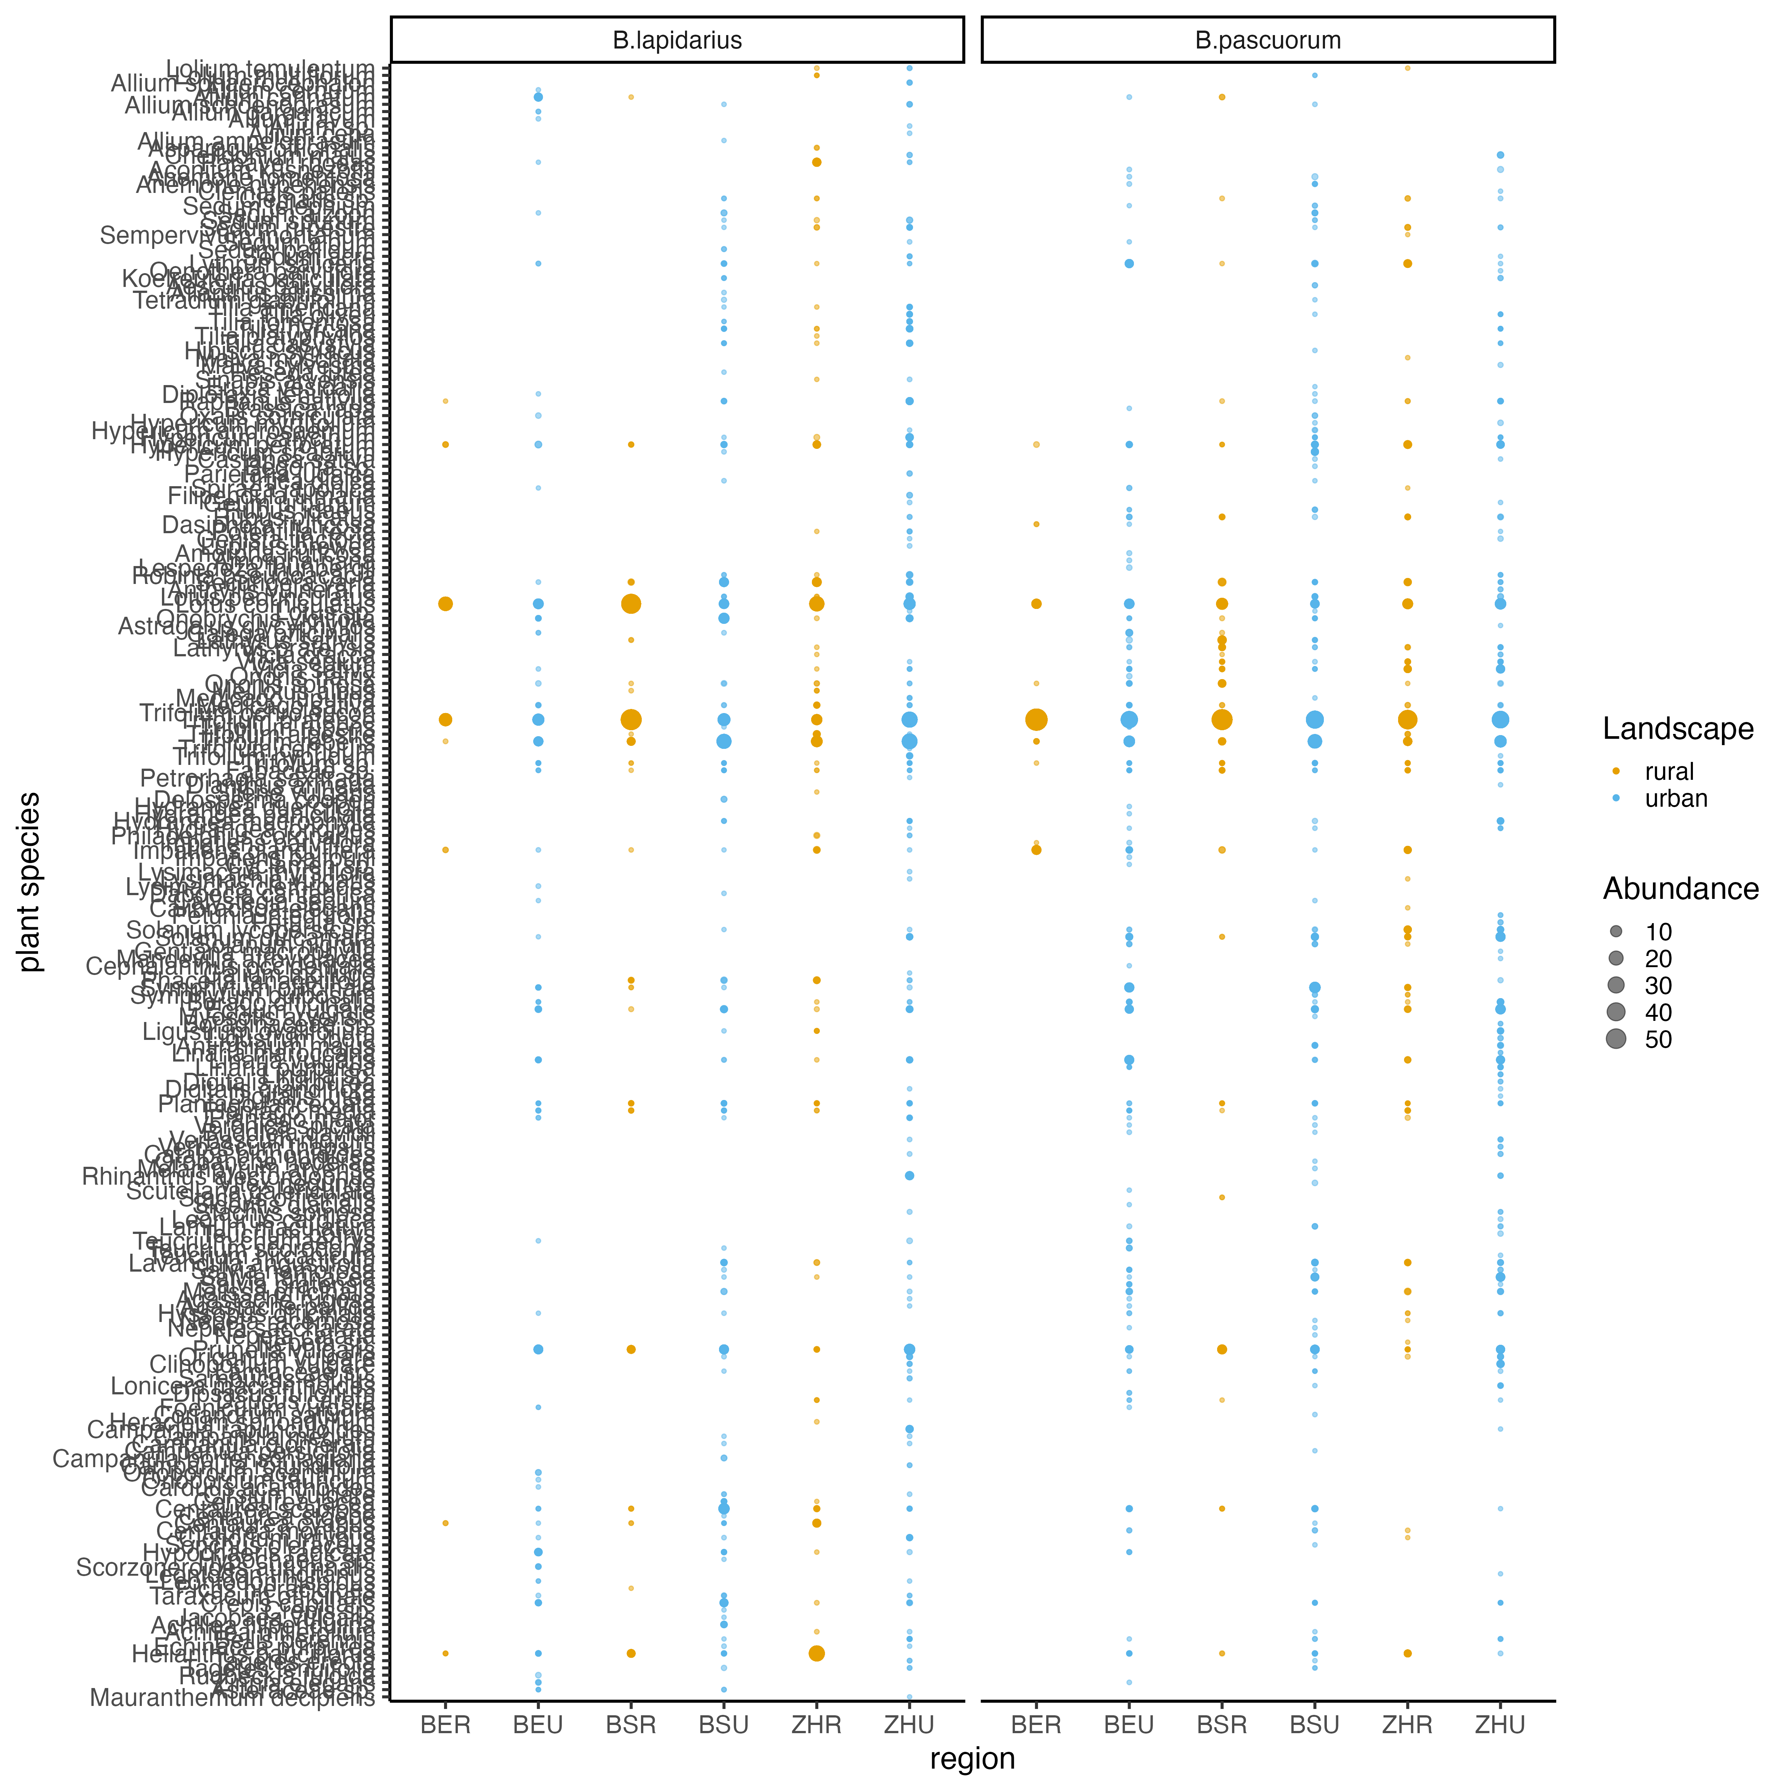
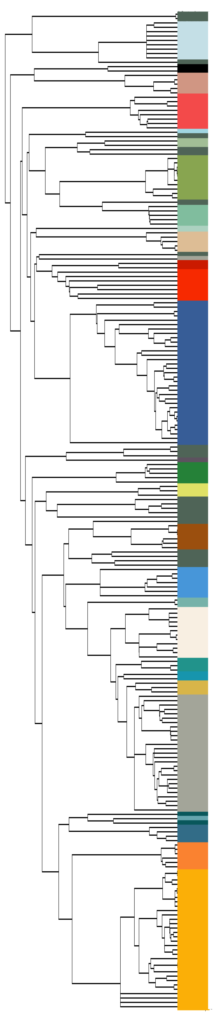
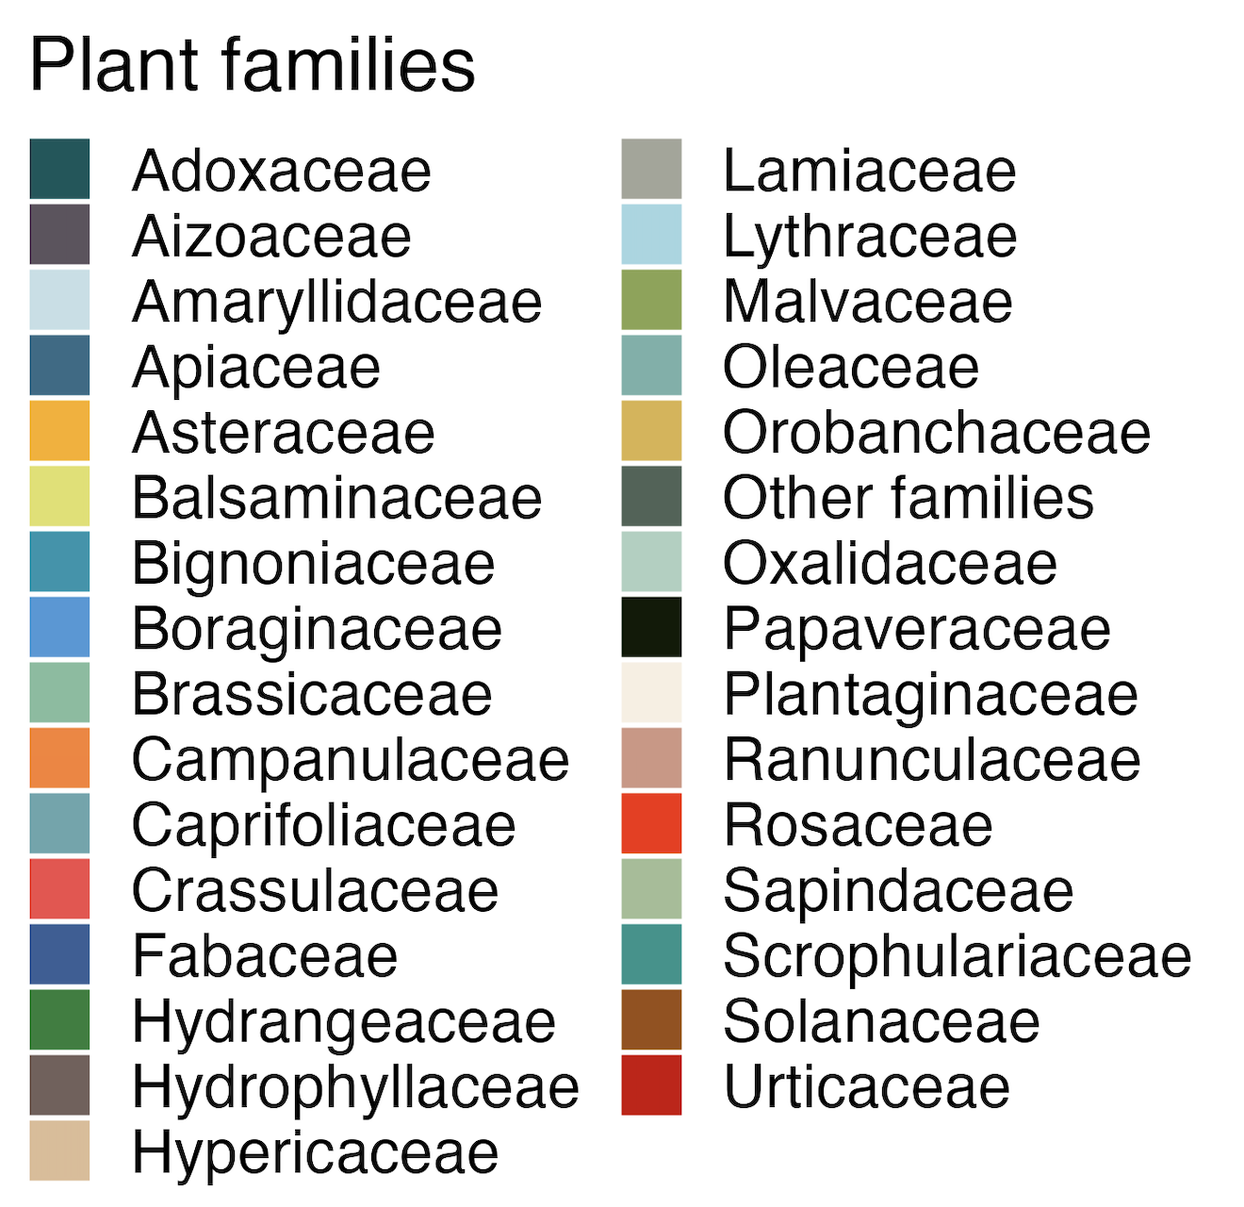
Taxa
31
86
48
24
54
9
91
8
52
77
100
77
Bern
Basel
Zurich
region
Bern
Basel
Zurich

Slide 2
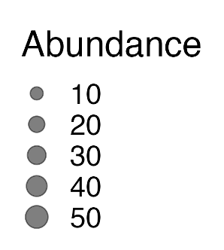
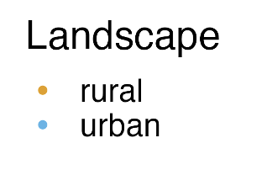
Taxa
31
86
48
24
54
9
91
8
52
77
100
77
Bern
Basel
Zurich
region
Bern
Basel
Zurich

Slide 4
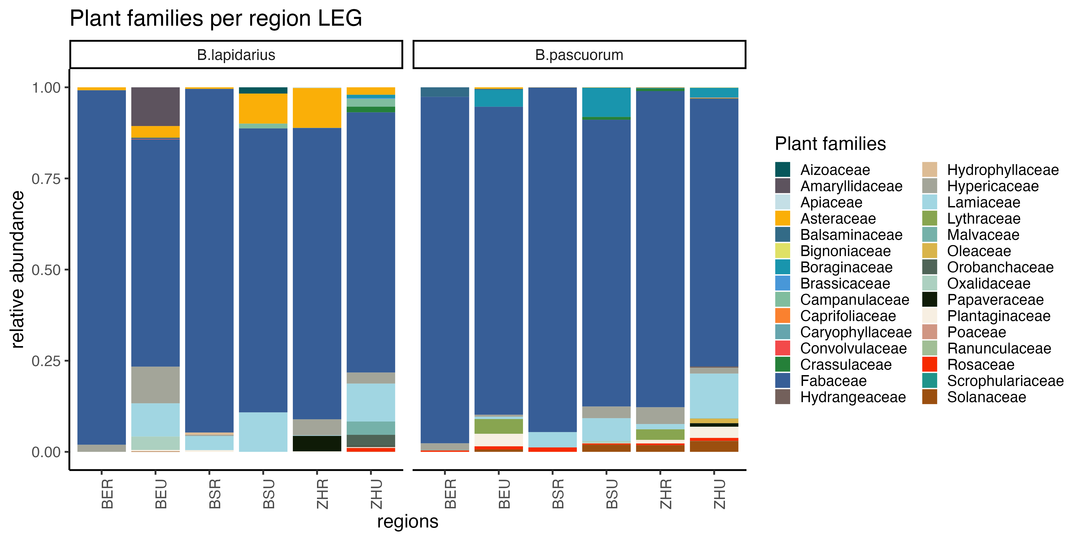

Slide 5
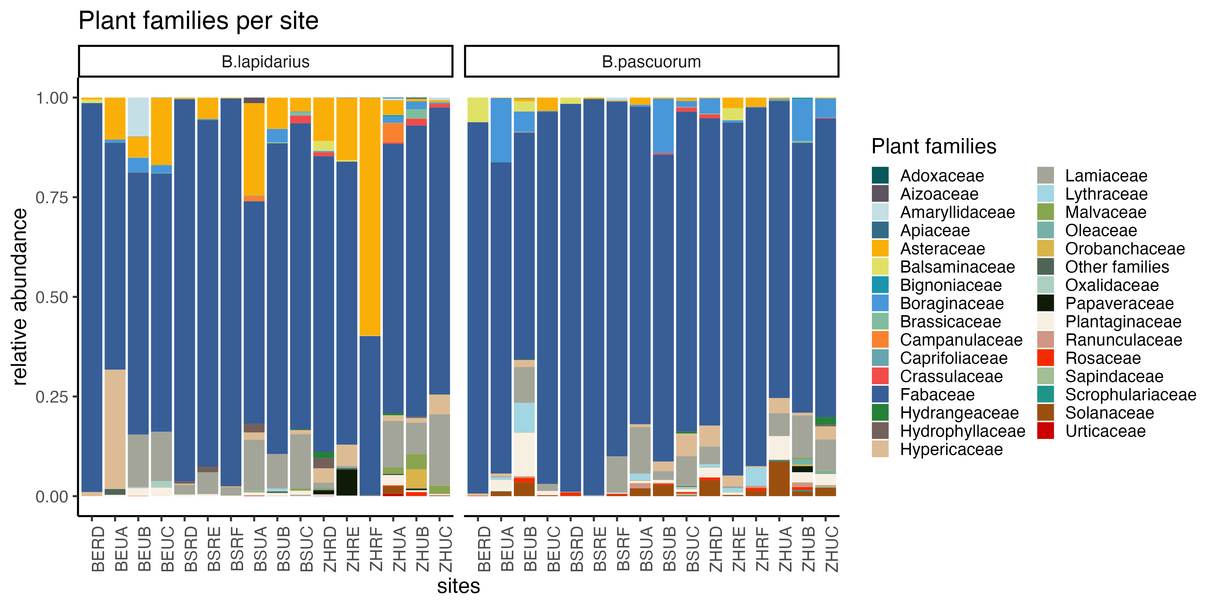

Slide 6
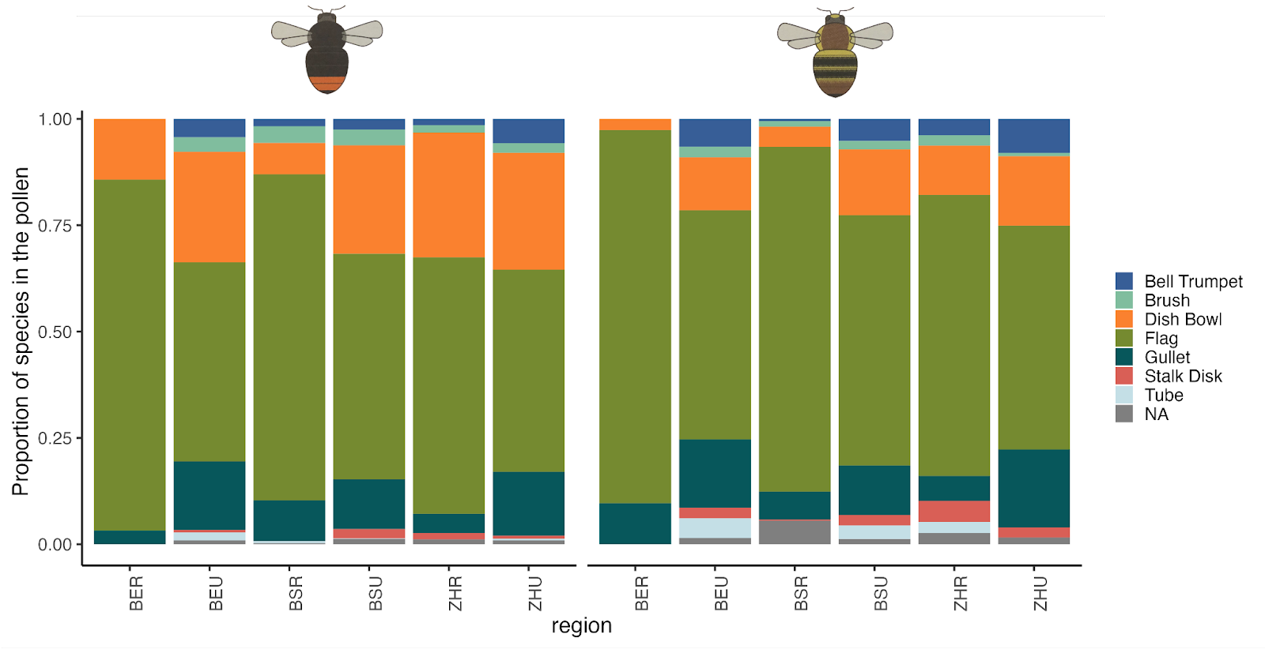
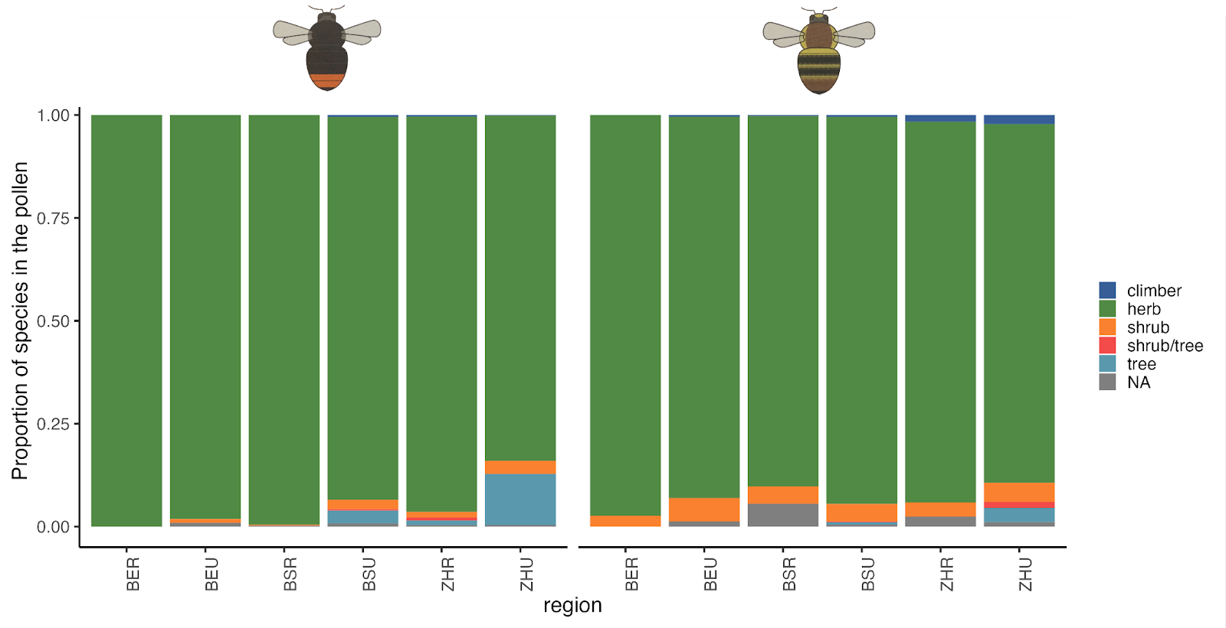
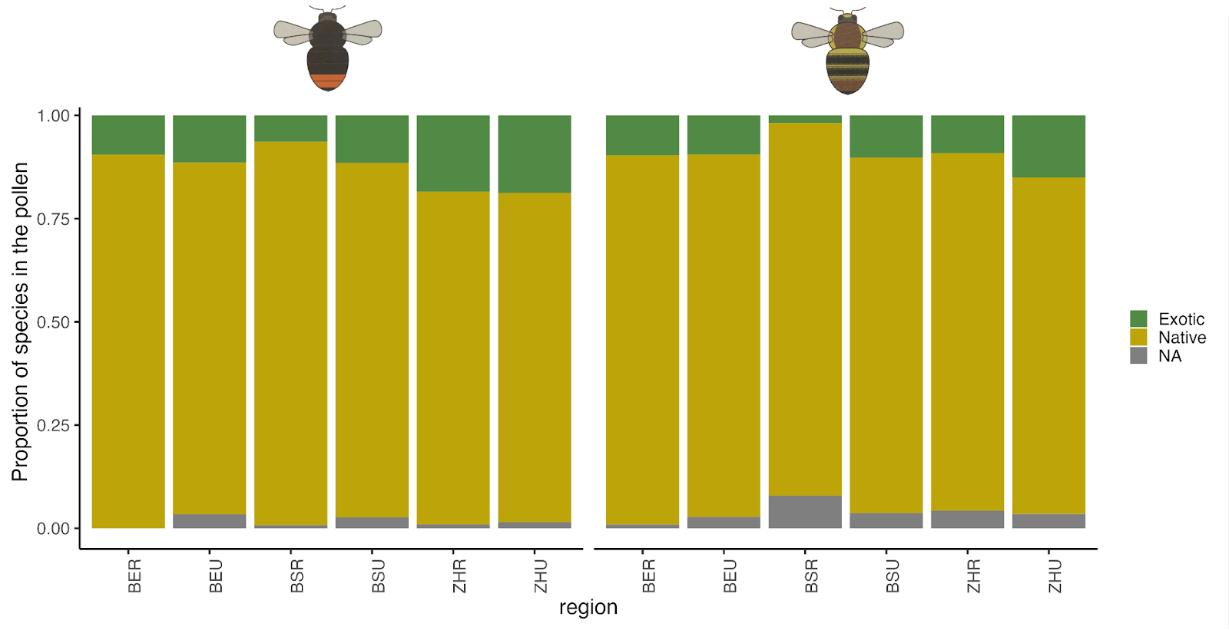

Slide 7
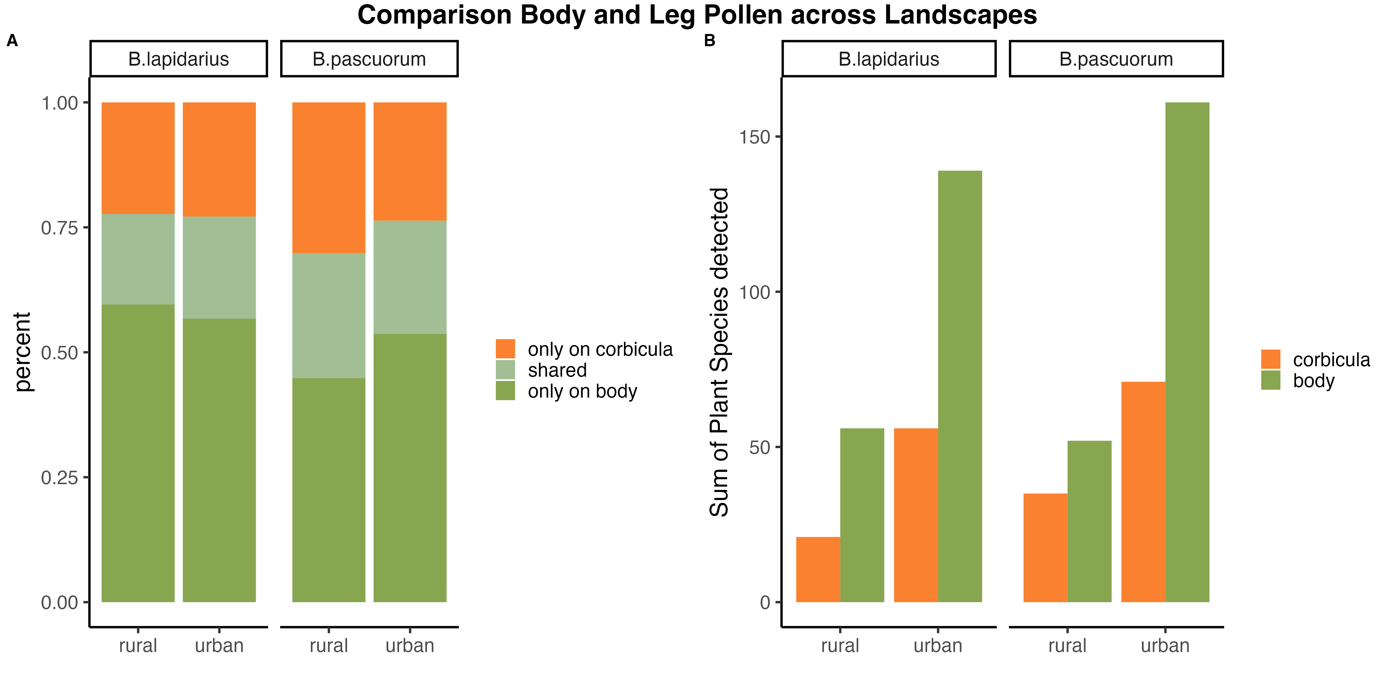



Slide 8
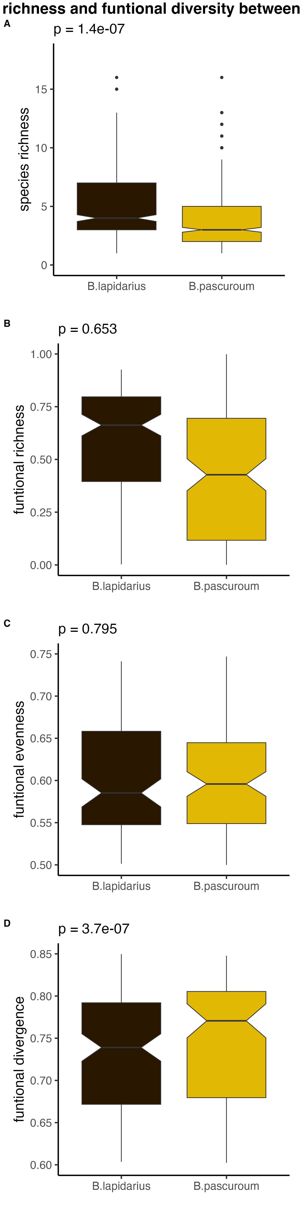
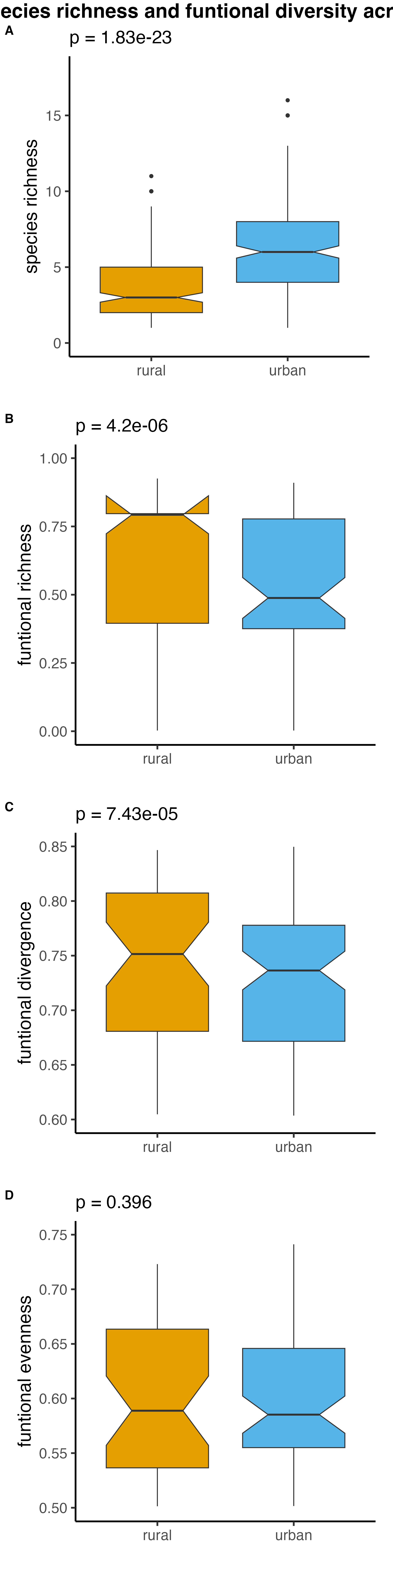
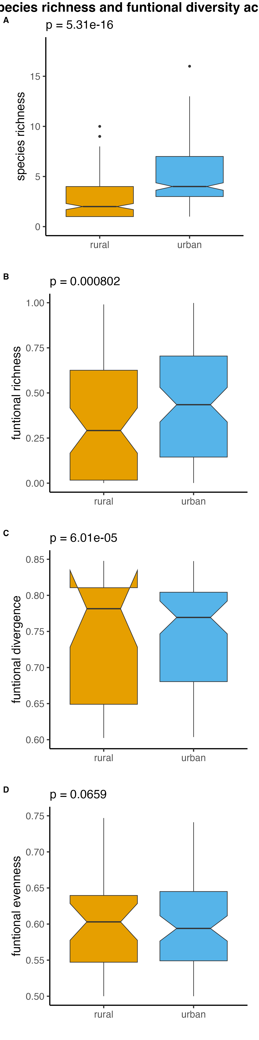
A
***
A
***
***
B
n = 478
n = 535
B
n = 233
n = 245
n = 243
n = 292
B
***
***
C
n = 363
n = 333
C
n = 143
n = 220
n = 110
n = 223
D
n = 363
n = 333
D
n = 143
n = 220
n = 110
n = 223
***
***
***
n = 363
n = 333
n = 143
n = 220
n = 110
n = 223

Slide 9
A
***
***
B
n = 233
n = 245
n = 243
n = 292
B
***
***
C
n = 143
n = 220
n = 110
n = 223
D
n = 143
n = 220
n = 110
n = 223
***
***
n = 143
n = 220
n = 110
n = 223

Slide 10
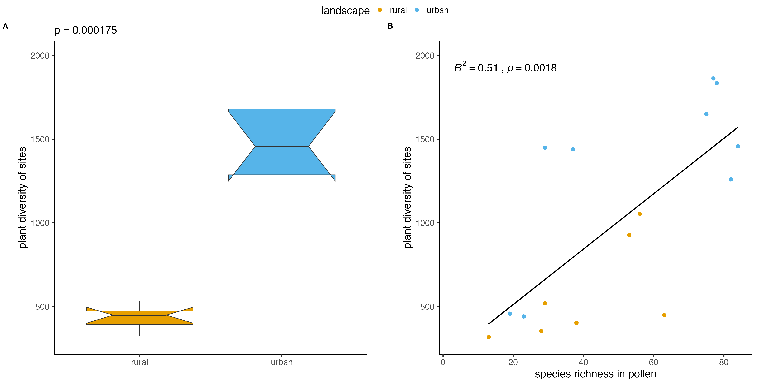
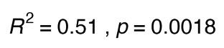


Slide 11
A
B

Slide 12
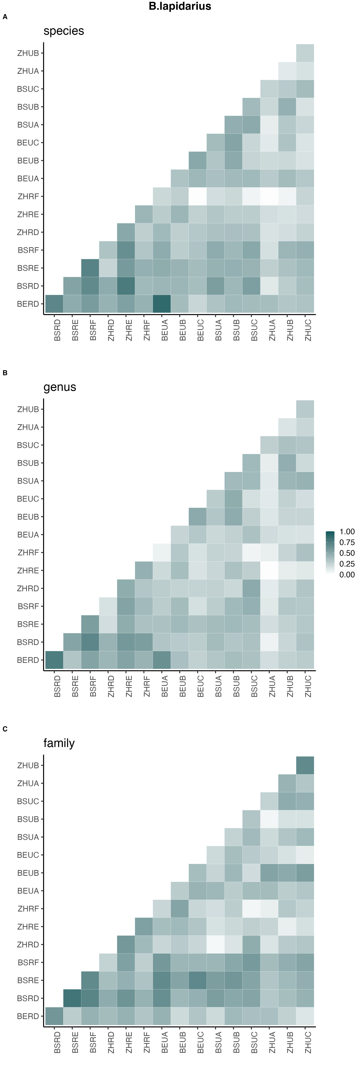
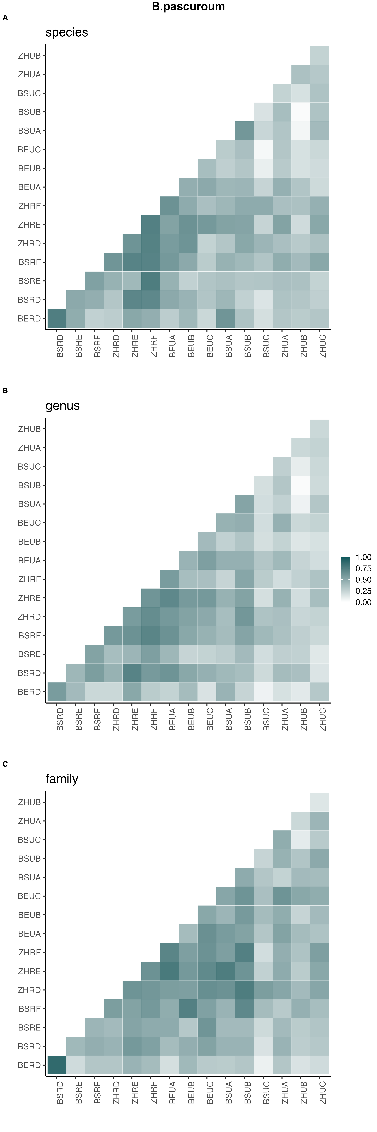
A
B
C

Slide 13
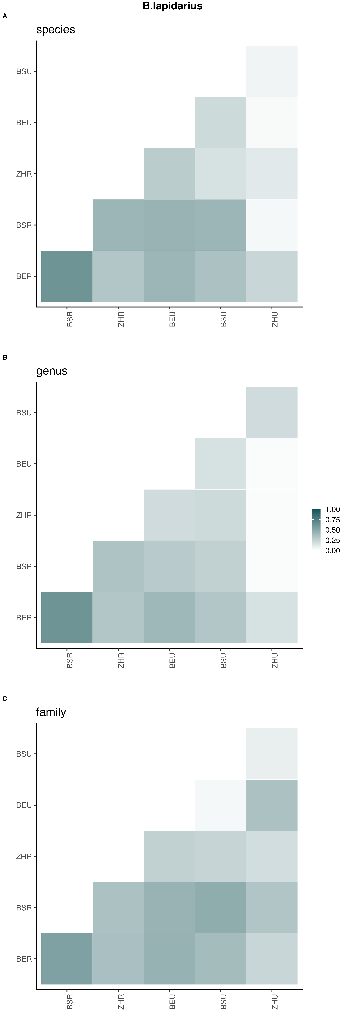
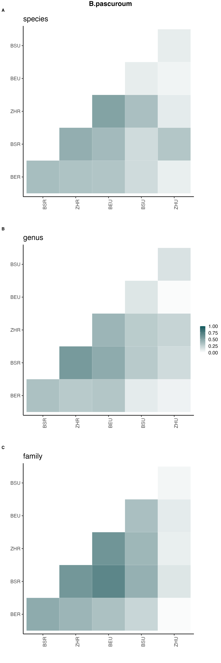
A
Basel
Basel
urban
urban
Bern
Bern
Zurich
Zurich
Basel
Basel
rural
rural
Bern
Bern
rural
urban
rural
urban
B
Basel
Zurich
Bern
Basel
Zurich
Basel
Zurich
Bern
Basel
Zurich
Basel
Basel
urban
urban
Bern
Bern
Zurich
Zurich
Basel
rural
Basel
rural
Bern
Bern
rural
urban
rural
urban
C
Basel
Zurich
Bern
Basel
Zurich
Basel
Zurich
Bern
Basel
Zurich
Basel
Basel
urban
urban
Bern
Bern
Zurich
Zurich
Basel
rural
Basel
rural
Bern
Bern
rural
urban
rural
urban
Basel
Zurich
Bern
Basel
Zurich
Basel
Zurich
Bern
Basel
Zurich

Slide 14
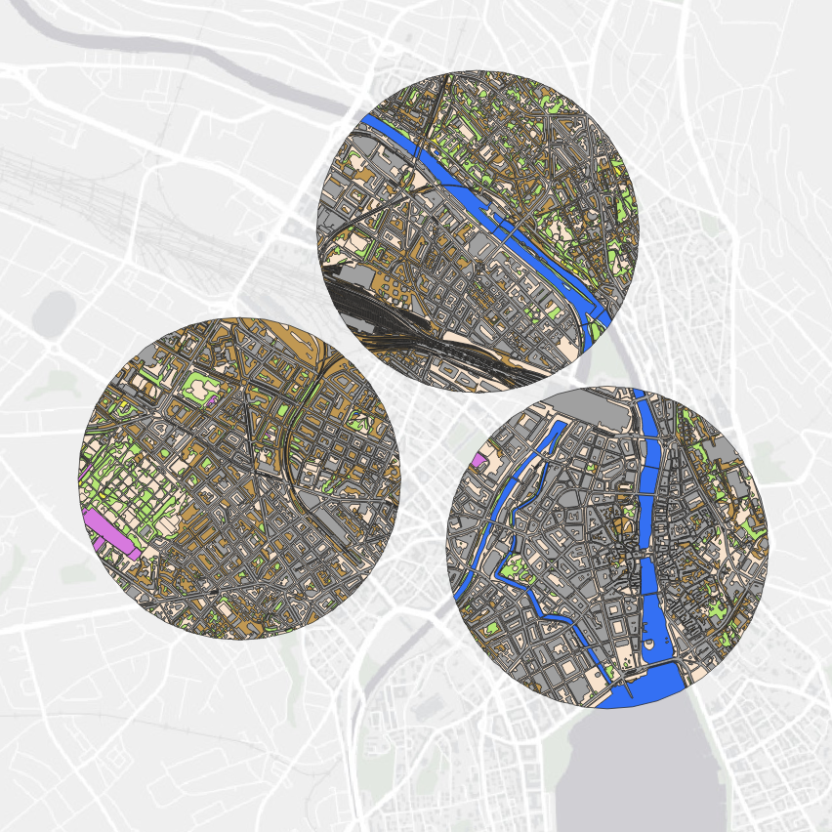
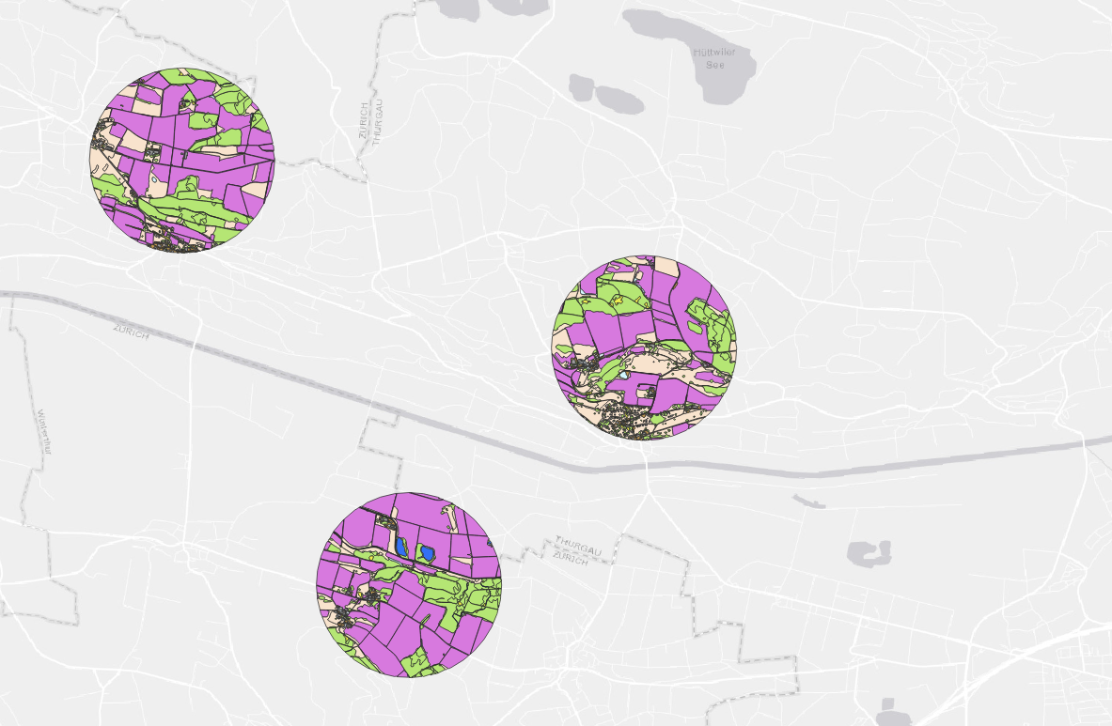
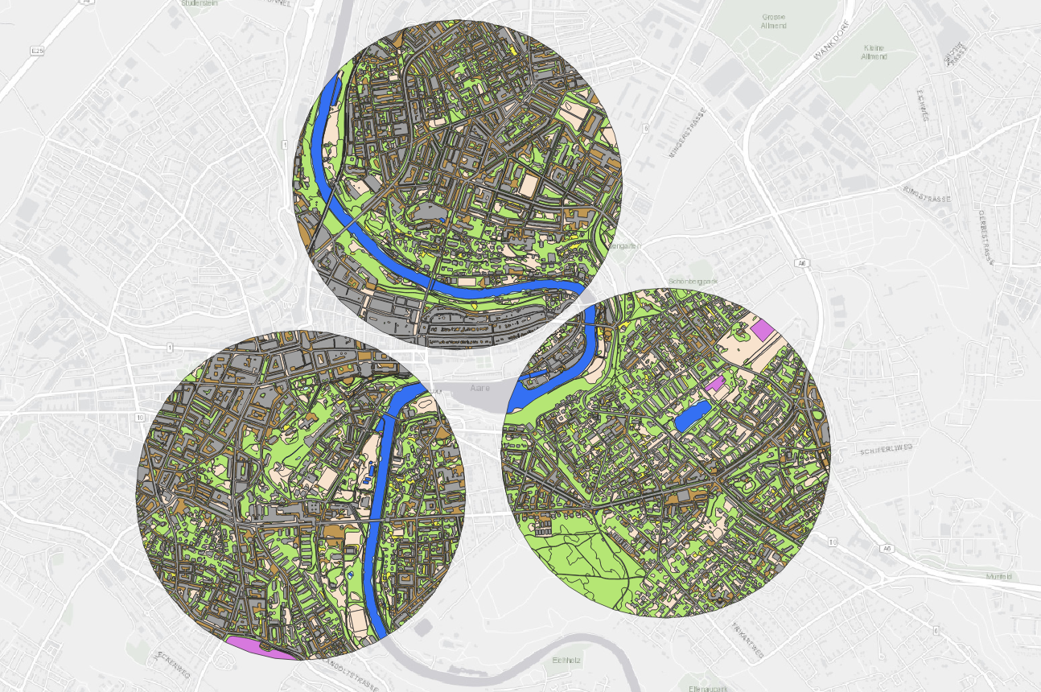
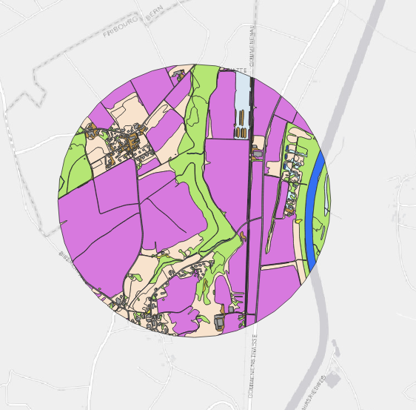
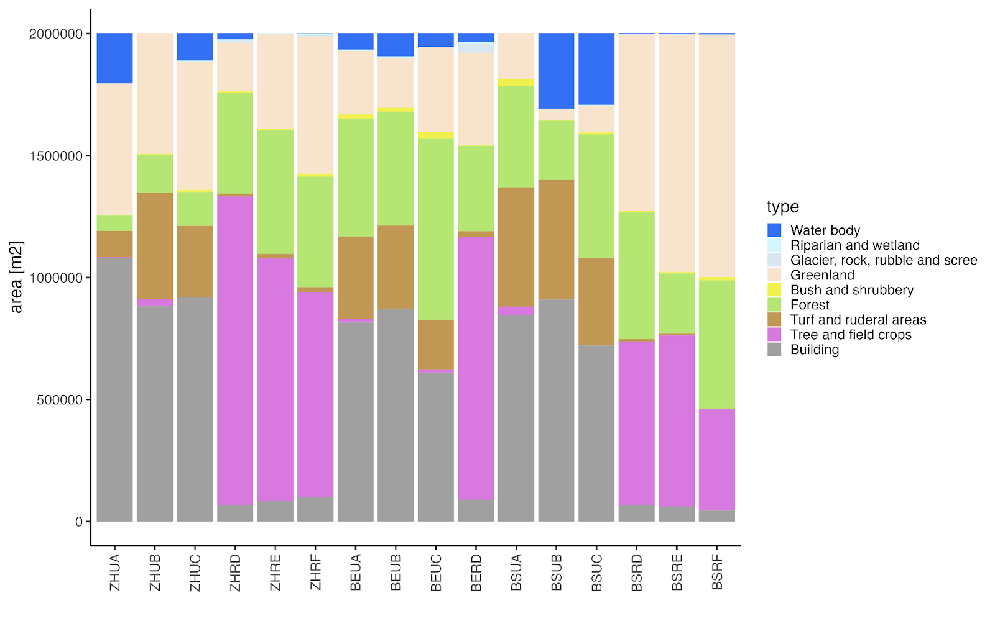
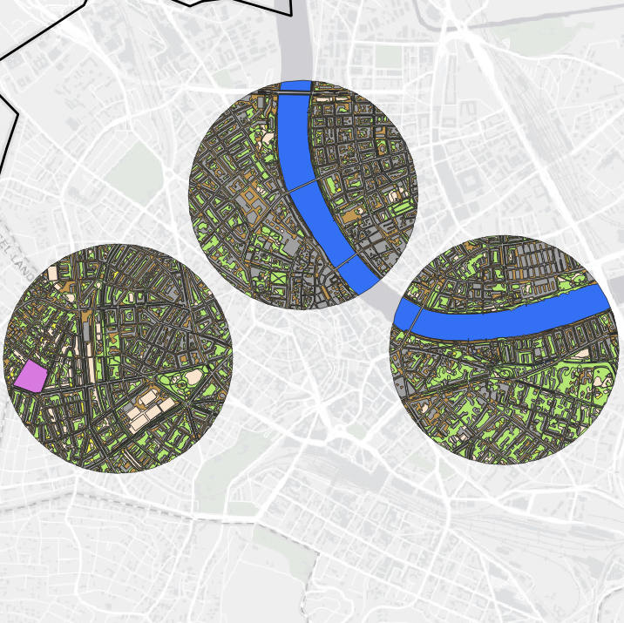
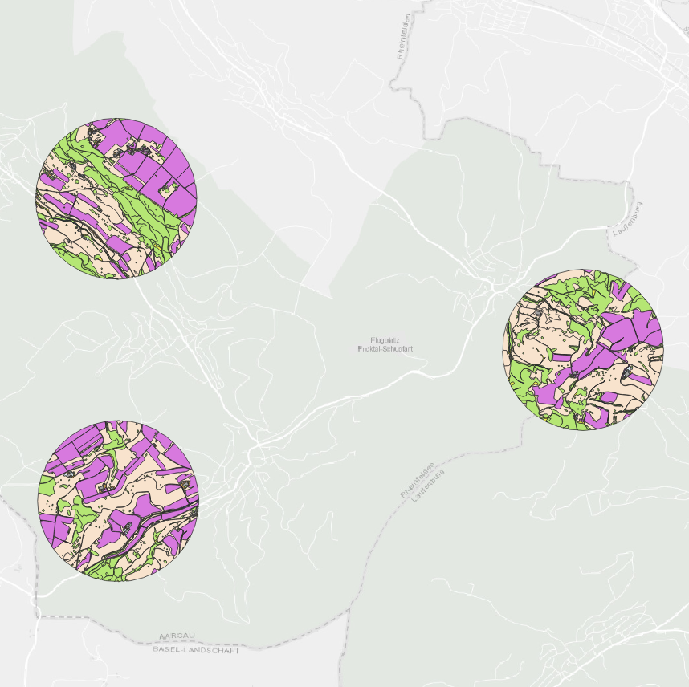
A
C
E
B
B
A
F
D
Zurich urban
Zurich rural
B
D
A
C
C
Bern urban
Bern rural
B
D
A
C
F
E
Basel urban
Basel rural

Slide 15
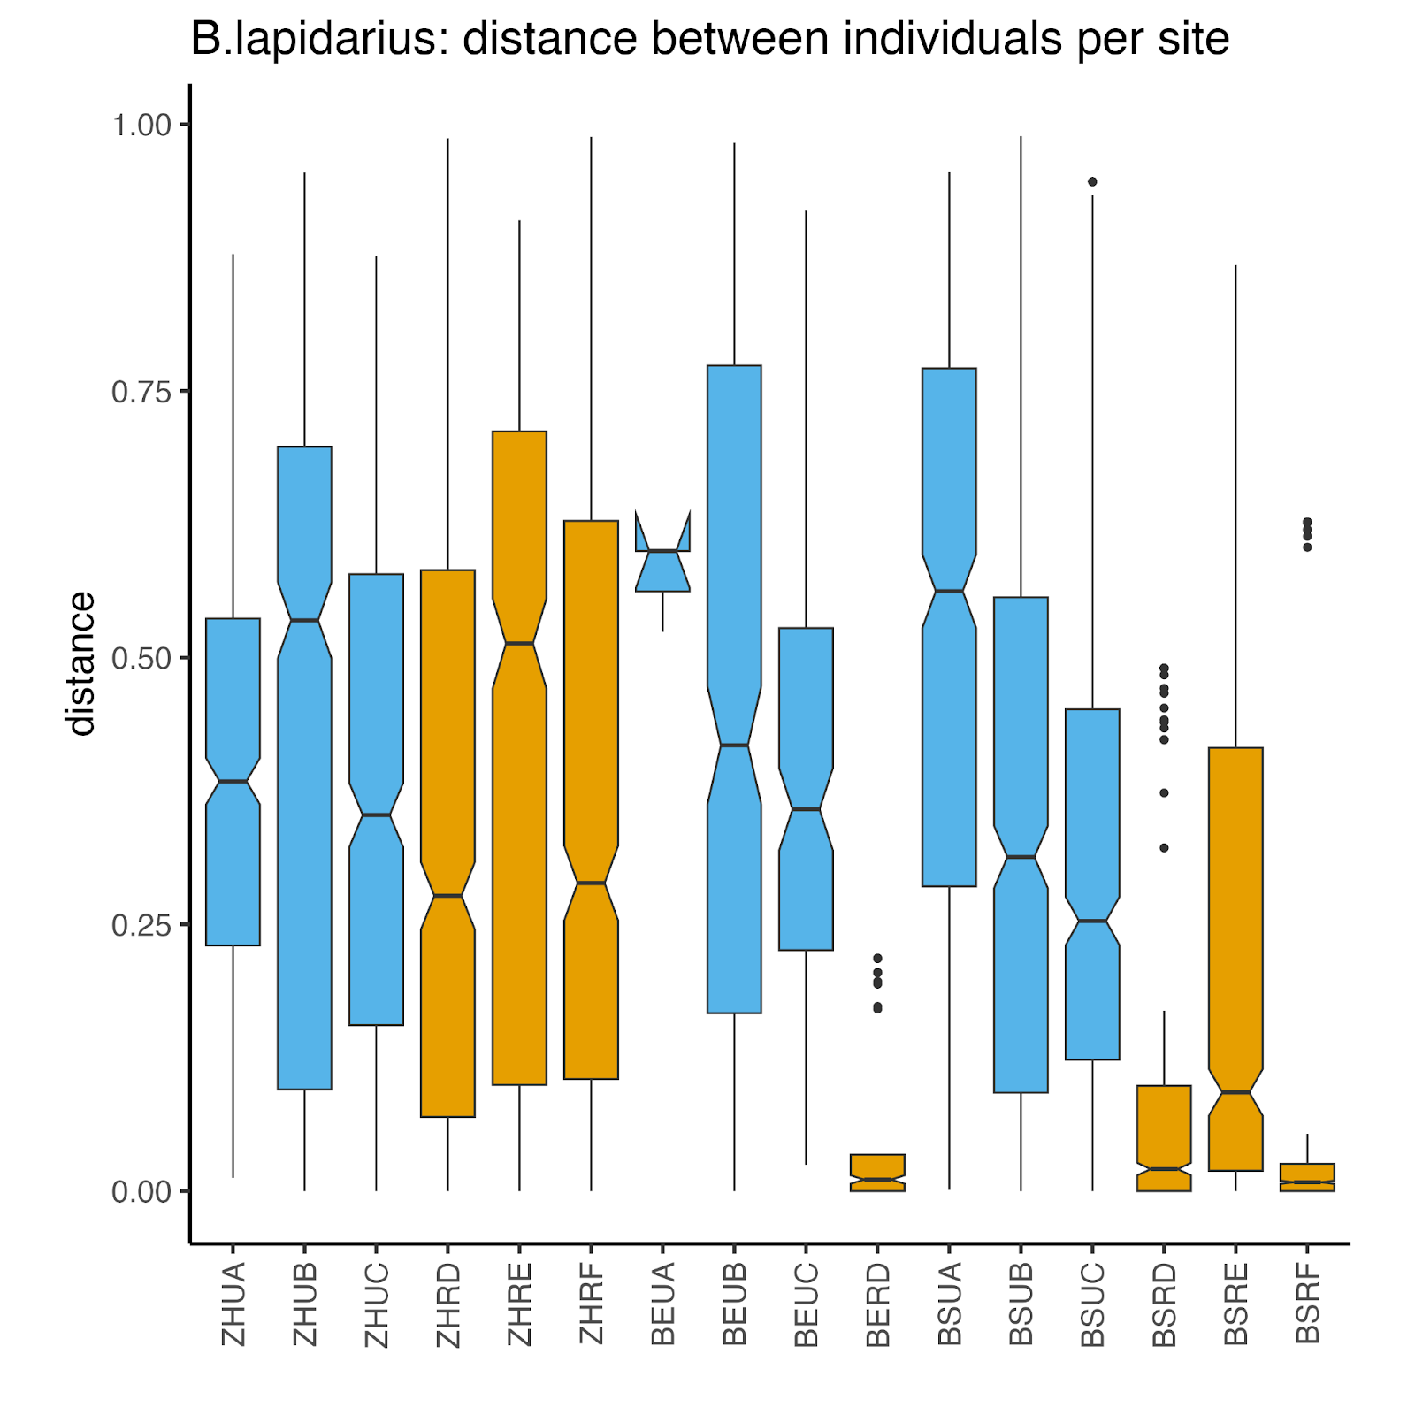
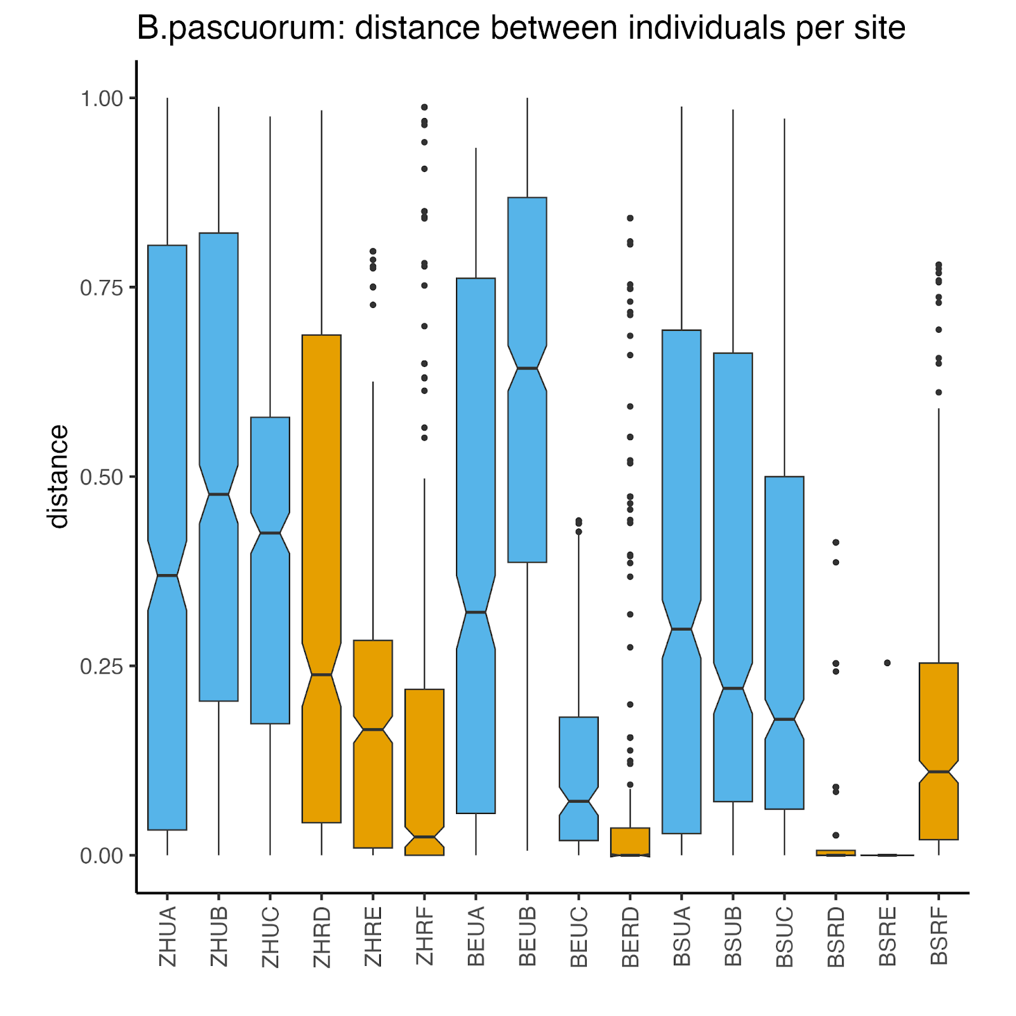

Slide 16
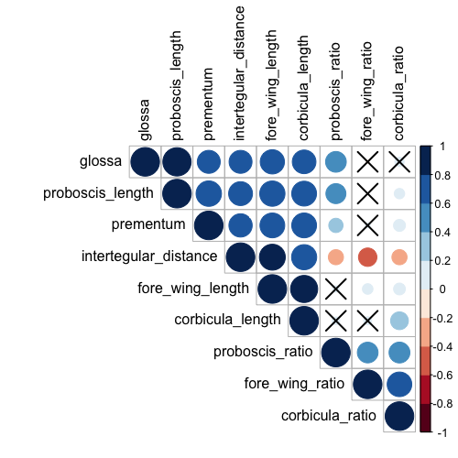
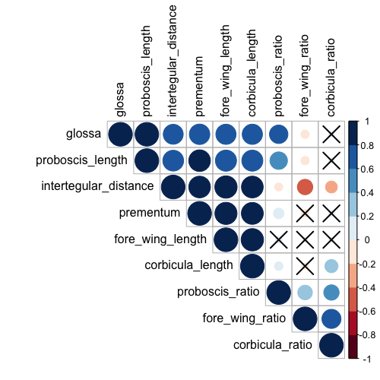

Slide 17
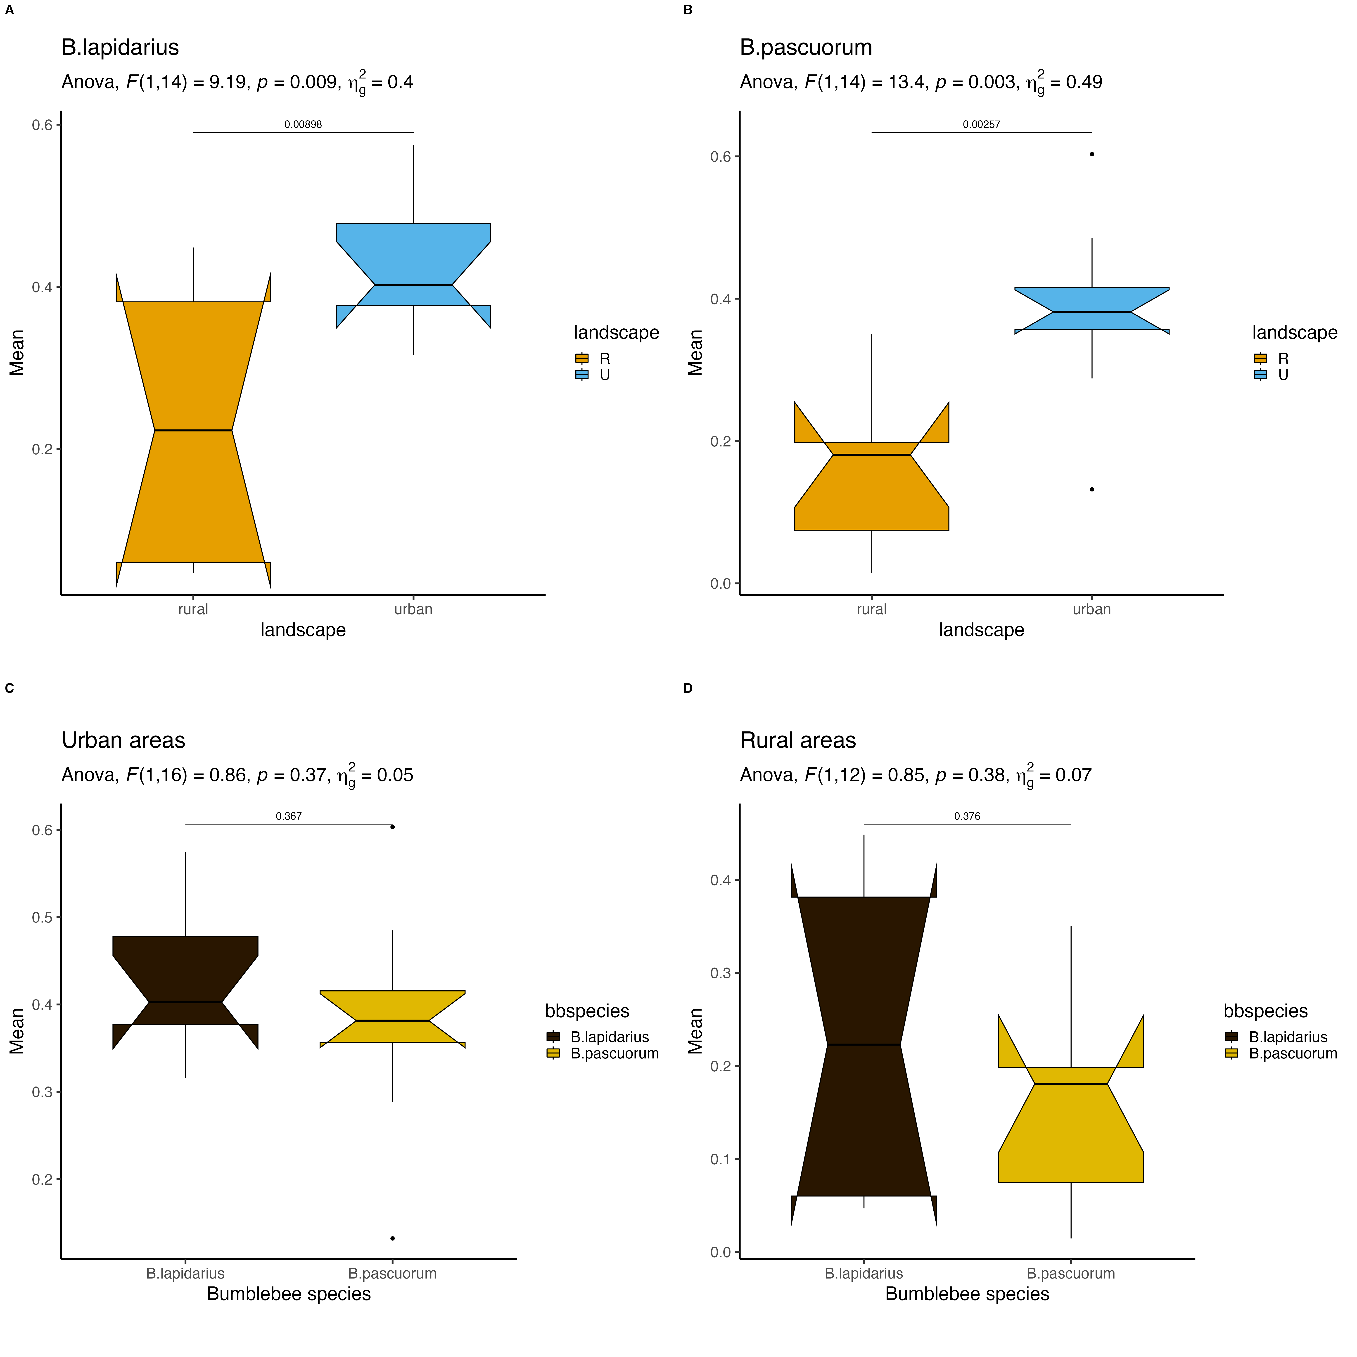
A
B
C
D

Slide 18
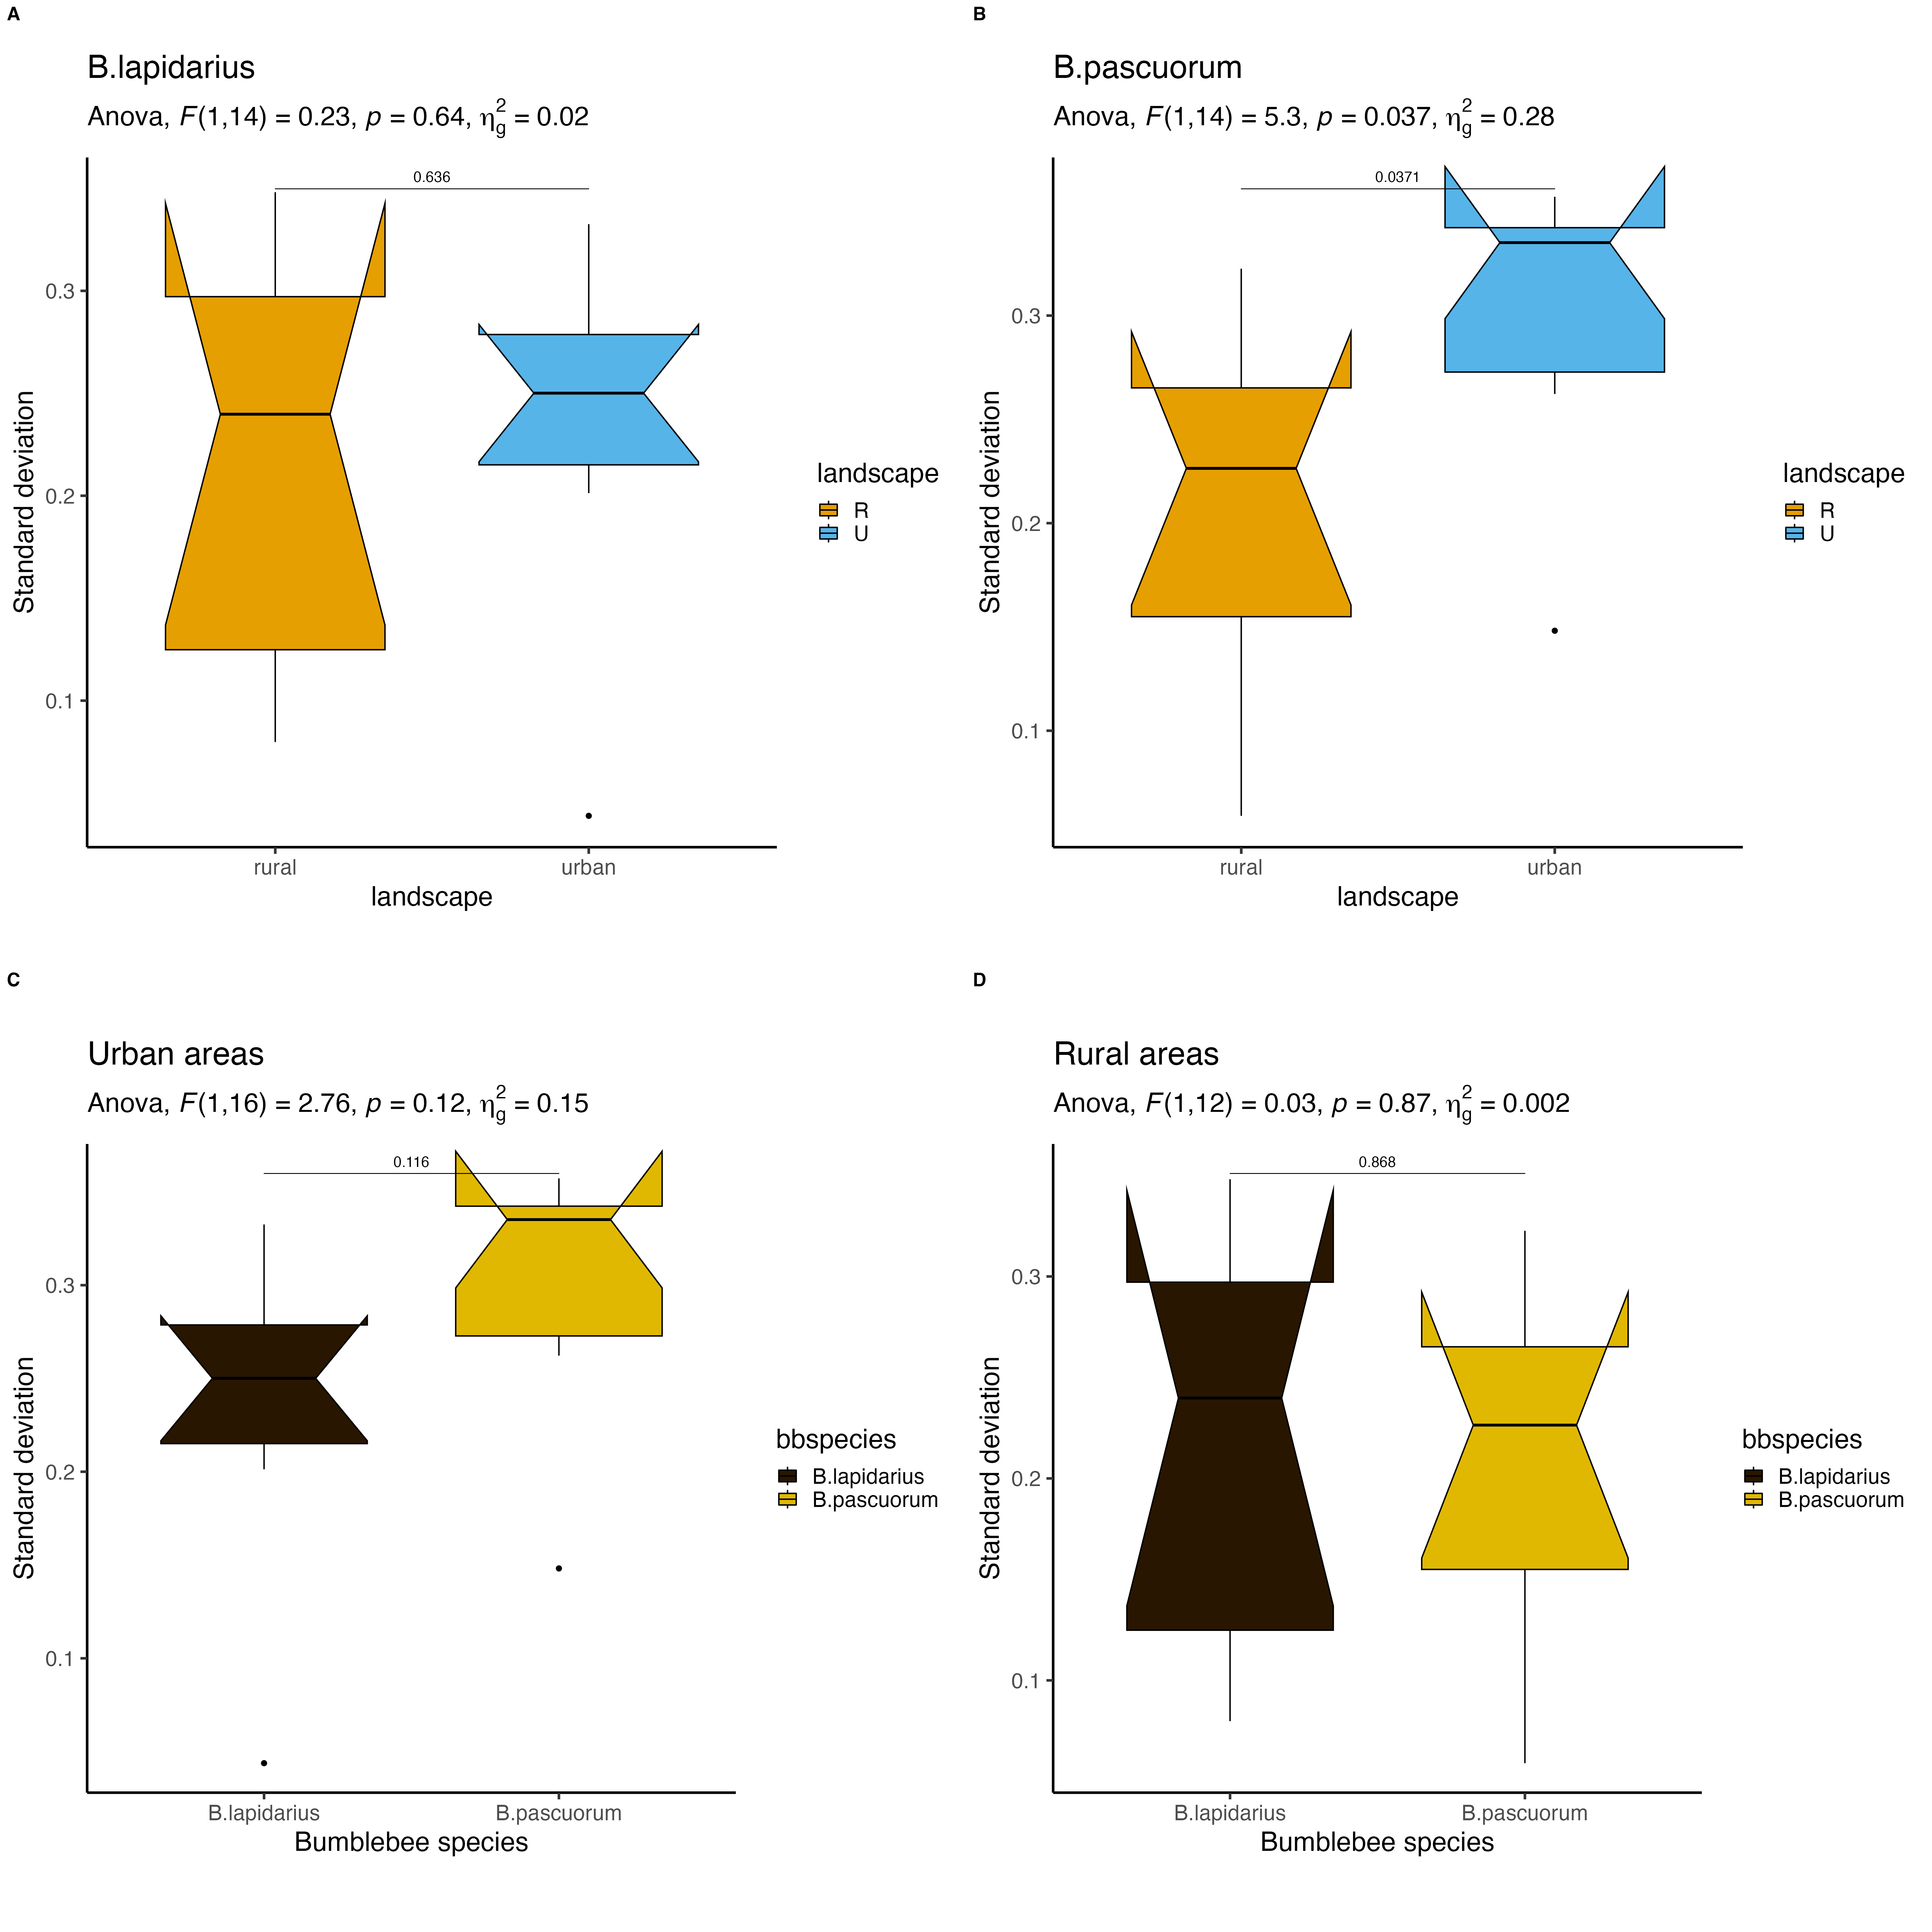
A
B
C
D

Slide 19
